Slide 1

Reviving Airbnb NYC Business in the Post-COVID Period
Notes:
Objective

Slide 2
AGENDA
Objective
Background
Key findings
Recommendations
Appendix
Data sources
Data methodology
Data model assumptions
Notes:
Objective

Slide 3
OBJECTIVES
Improve strategies to revive the business in the post-COVID period.
Understand customer preferences and user experience trends for Airbnb NYC business.
Provide early recommendations for new acquisitions and for improving customer experience.
Notes:
Objective

Slide 4
BACKGROUND
The COVID-19 pandemic affected Airbnb business due to travel restrictions.
The revenue took the largest hit in NYC in the Q2 of 2020.
Now that the travel restrictions are lifted, the business should be operated to recover the loss.
Notes:
Objective

Slide 5
TARGET HOSTS OFFERING THE LEAST ‘MINIMUM NIGHTS OF STAY’
In the past, it has been observed that most bookings are done for apartments, where the minimum number of nights’ stay is the least.
For a minimum stay of 0 to 5 nights, the maximum number of listings went beyond 12K in the past.
Besides, properties with a minimum stay of 30 nights should also be acquired as they have market traction.
Assumption
With COVID-19, it is reasonable to assume that people will book properties for monthly stays or for a minimum of 30 nights.
Notes:
Objective

Slide 6
PROPERTIES WITH THE LEAST ‘MINIMUM NIGHTS OF STAY’ GET MAXIMUM BOOKINGS
Acquiring premium properties should not be prioritised as of now, due to higher pricing.
As the number of nights to stay increases, the price increases and the bookings naturally go down.
It has been observed that the hosts offering minimum nights to stay have received the most bookings in the past.
Notes:
Objective

Slide 7
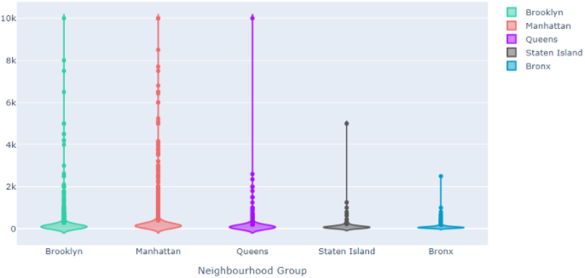
ACQUIRING PREMIUM PROPERTIES IN BRONX AND NON-PREMIUM PROPERTIES IN MANHATTAN
Premium properties in Bronx should be targeted as the rates are already reasonable.
Non-premium properties in Manhattan should be targeted as the rates are already pricey and a reasonable approach will get more customers.
The properties in Manhattan are the most expensive, while those in Bronx are the least expensive.
Notes:
Objective

Slide 8
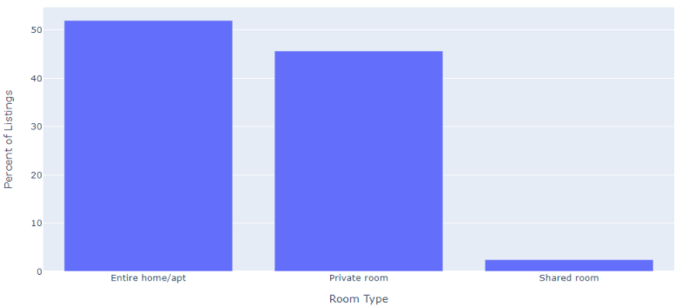
CUSTOMER PREFERENCES FOR ‘ENTIRE HOME/PRIVATE ROOM’ SHOULD REMAIN HIGH POST COVID
Customers prefer Entire home/apt or Private room.
The room types ‘Entire home/apt’ and ‘Private room’ account for most of the listed properties (around 97.6%).
Shared rooms account for only 2.4% of the total listed properties.
Notes:
Objective

Slide 9
APPENDIX – OTHER INSIGHTS
Most listings are hosted by a single host each.
Manhattan has a 14.7% higher contribution of ‘Entire home/apt’ compared to the overall contribution of ‘Entire home/apt’.
Queens has a 23.2% higher contribution of ‘Private room’ compared to the overall contribution of ‘Private room’.
Notes:
Objective

Slide 10
APPENDIX – DATA METHODOLOGY
We conducted a thorough analysis of the Airbnb data. The process included:
Cleaning the data set of missing values and outliers
Using exploratory data analysis to identify customer preferences based on:
Area preferences
Price
Listing preference
Notes:
Objective

Slide 11
APPENDIX – DATA ASSUMPTIONS
We assumed the data prior to the COVID-19 period was achieving the desired revenue.
We assumed the company does not want to expand yet to new territories in NYC.
The company’s strategies are decided considering the travel will increased in the post COVID period.
Notes:
Objective

Slide 12
OBJECTIVES
Improve strategies to revive the business in the post-COVID period.
Understand key insights from Airbnb NYC business in the pre-COVID period.
Estimate customer preferences for the post-COVID period travel.
Notes:
Objective

